Slide 1


Indonesia Bank Stock Visualization
Feni Ismiati | ismiatifeni6@gmail.com | 6282210023177

Slide 2
Background
The Indonesia Bank Stock Visualization project aims to provide a comprehensive analysis of historical stock data by focusing on 6 bank stocks. This project explores the patterns and relationships among bank stocks over the period of time. Understanding these patterns and relationships are crucial for analysts looking to be informed based on historical performance.
Feni Ismiati | ismiatifeni6@gmail.com | 6282210023177

Slide 3
Objectives
The project aims to achieve the following objectives
1.
Maximum and Minimum Closing Price
4.
Volatility Analysis
Identify the maximum and minimum closing prices for each bank stock
Identify the most volatile and the most stable bank stocks based on the standard deviation of returns
2.
Specific Dates for Maximum and Minimum Returns
5.
Correlation Analysis
Determine the specific dates when each bank stock reached its maximum and minimum return
Examine the correlation between each pair of bank stocks to determine the strength of their relationships
3.
Average Return for Each Bank Stock
Calculate the average return to assess the overall performance of each bank stocks
Feni Ismiati | ismiatifeni6@gmail.com | 6282210023177

Slide 4
❗️Disclaimer❗️
This project is intended for educational and analytical purposes. It shows the actual historical data of Indonesian Bank Stocks and doesn't serve as a recommendation or endorsement of any specific bank stock. The information provided here should not be interpreted as investment advice. Please conduct your own research or consult with a financial advisor before making any investment decisions.
Feni Ismiati | ismiatifeni6@gmail.com | 6282210023177

Slide 5
Method
Installation
Data Collection
Collect BBCA, BBRI, BMRI, BNLI, BBNI, BNGA, MEGA historical data
Install pandas-datareader
and Yahoo Finance
EDA
Volatility Analysis
Correlation Analysis
Visualization
Calculate the standard deviation to identify the volatility
Create a Heatmap to visualize the correlation coefficients to identify the strength of the relationships between each pair of bank stocks
Create a Pairplot to identify the relationships
Analyze closing prices
Identify the specific dates of returns
Calculate the average return
Use Pyplot to create trendline of Close prices over time
Feni Ismiati | ismiatifeni6@gmail.com | 6282210023177

Slide 6
Installation
Feni Ismiati | ismiatifeni6@gmail.com | 6282210023177

Slide 7
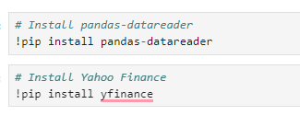
Installation
Install pandas-datareader: it is a Python library that allows easy access to financial data from various online sources directly into Pandas dataframes
Install Yahoo Finance: in this project, Yahoo Finance source is used to fetching the data. Yahoo Finance also provides a wide range of financial data, including stock prices, dividends, and splits
Feni Ismiati | ismiatifeni6@gmail.com | 6282210023177

Slide 8
Data Collection
Feni Ismiati | ismiatifeni6@gmail.com | 6282210023177

Slide 9
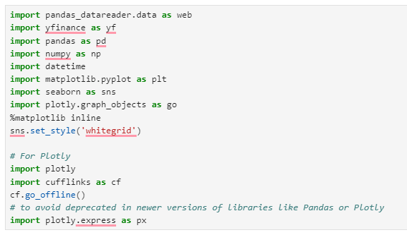
Import Libraries
There are several libraries used in this project
Data Collection: pandas_datareader and yfinance to gather the up-to-date financial data
Data Analysis: pandas and numpy to robust data manipulation and essential for calculating returns, average, and standard deviation
Visualization: matplotlib, seaborn, and plotly provide tools for creating interactive graphs, and explore trends, correlations, and patterns.
Integration: cufflinks and plotly.express to create interactive plots from dataframes and explanatory analysis
Feni Ismiati | ismiatifeni6@gmail.com | 6282210023177

Slide 10
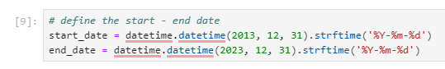

2. Determine the Data
In this project, the historical of bank stock data is from period 31 December 2013 to 31 December 2023
These are the Indonesia's Bank Stocks used in this project:
PT Bank Central Asia Tbk (BBCA)
PT Bank Rakyat Indonesia (Persero) Tbk (BBRI)
PT Bank Mandiri (Persero) Tbk (BMRI)
PT Bank Permata Tbk (BNLI)
PT Bank Negara Indonesia (Persero) Tbk (BBNI)
PT Bank CIMB Niaga Tbk (BNGA)
PT Bank Mega Tbk (MEGA)
Feni Ismiati | ismiatifeni6@gmail.com | 6282210023177

Slide 11
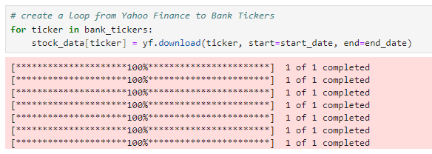
3. Download the Data
Retrieve financial data from Yahoo Finance using yfinance library to download the data.
The download code is a method from the yfinance library that retrieves stock data for the specified ticker.
The ticker used is the bank stock symbol to download the data and store in the stock_data dataframe
Feni Ismiati | ismiatifeni6@gmail.com | 6282210023177

Slide 12
EDA
(Exploratory Data Analysis)
Feni Ismiati | ismiatifeni6@gmail.com | 6282210023177

Slide 13
In this section, there are several objectives that need to be answered using Exploratory Data Analysis (EDA)
Analyze maximum and minimum Close price
EDA
Identify the specific dates of returns
Calculate the average return
Feni Ismiati | ismiatifeni6@gmail.com | 6282210023177

Slide 14
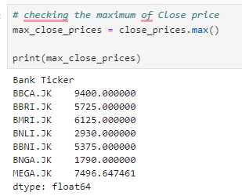
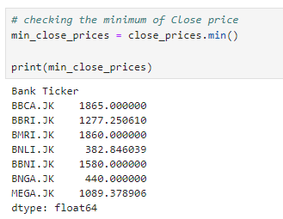
Analyze maximum and minimum Close price
What is the maximum and minimum closing price for each bank stock during the specified period?
Maximum Close price
Minimum Close price
Create max.( ) and min.( ) from pandas library to determine the maximum and minimum of Close price for each bank stock. It shows that the range of maximum close price is 1,790 - 9,400. Meanwhile the range of minimum close price is 382 - 1,865.
Feni Ismiati | ismiatifeni6@gmail.com | 6282210023177

Slide 15
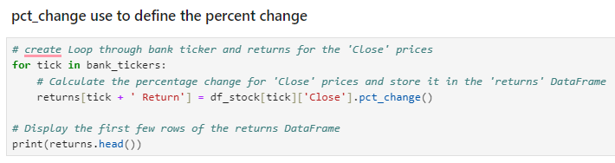
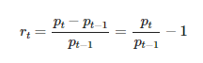
Identify the specific dates of returns
On which specific dates did each bank stock reach its maximum and minimum return values?
First, we should know what does Return mean? Return is basically represent the gain or loss of an investment over a specified period. Therefore, Return calculation is:
Processing
rt​: the return of the stock at time t. This represents the percentage change in the stock's price from the previous day
pt: the stock's closing price at time t. In this project t is current day
pt−1​: the stock's closing price at time t-1 or the previous day
So, to calculate the Return in bank stock, pct_change( ) function from Pandas is used to calculate the percentage change. This basically calculates the percentage change in the closing prices for each bank stock between the current and previous
Feni Ismiati | ismiatifeni6@gmail.com | 6282210023177

Slide 16
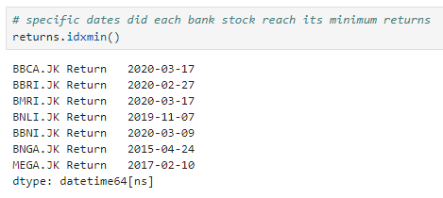
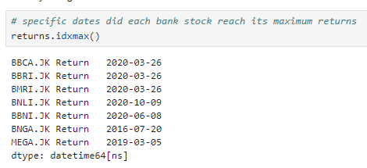
Identify the specific dates of returns
On which specific dates did each bank stock reach its maximum and minimum return values?
Minimum Return
Maximum Return
Findings
From the result above, it can be seen that mostly of the bank stock experience minimum and maximum returns on 2020 between February - March.
Feni Ismiati | ismiatifeni6@gmail.com | 6282210023177

Slide 17
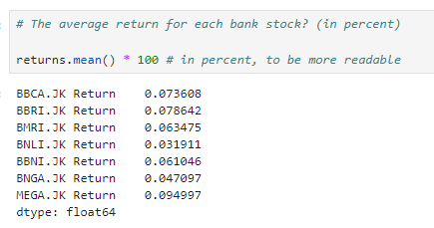
Calculate the average return
What is the average return for each bank stock over the analyzed period?
Calculate the average of Return for each of bank stock using .mean() function, *100 also to show it in percent format.
Findings
If we look at the result, it can be seen that the highest average of Return is coming from MEGA (0.094997%) compared to all the bank stocks. Meanwhile, the lowest average of Return is BNLI (0.031911%) over a period of given time
Feni Ismiati | ismiatifeni6@gmail.com | 6282210023177

Slide 18
Volatility Analysis
Feni Ismiati | ismiatifeni6@gmail.com | 6282210023177

Slide 19
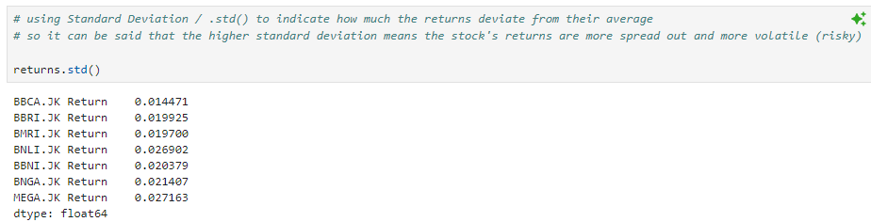
Calculate the standard deviation to identify the volatility
Which bank stock is the most volatile, and which is the most stable, based on their standard deviation of returns?
Findings
The result above shows that MEGA (0.027163) has the highest of standard deviation value which it can be said that MEGA is the most volatile or riskiest. Meanwhile, BBCA (0.014471) has the lowest of standard deviation, so it can be conclude that BBCA is the most stable compared to all bank stocks.
To answer which bank stock is the most volatile and most stable, .std( ) or standard deviation which used to indicate how much the returns deviate from their average. The conclusion is the higher standard deviation value means that the stock returns are more volatile or more riskiest.
Feni Ismiati | ismiatifeni6@gmail.com | 6282210023177

Slide 20
Correlation Analysis
Feni Ismiati | ismiatifeni6@gmail.com | 6282210023177

Slide 21
In this section, there are several objectives that need to be answered using Correlation
Create a Pairplot to identify the relationships
Correlation Analysis
Create a Heatmap to visualize the correlation coefficients to identify the strength of the relationships between each pair of bank stocks
Feni Ismiati | ismiatifeni6@gmail.com | 6282210023177

Slide 22
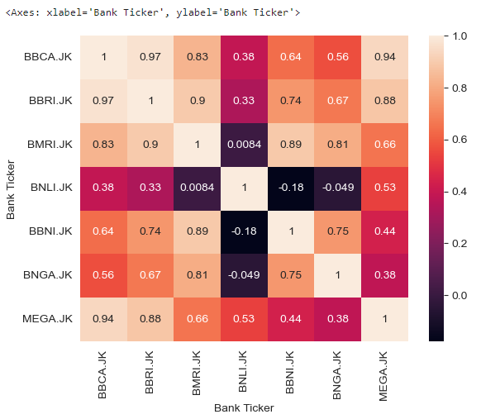
1. Create a Heatmap to visualize the correlation coefficients
What is the correlation between each pair of bank stocks, and how strong are these relationships?
Heatmap function .heatmap( ) to shows the strength of the correlation between different bank stocks, highlighting which stocks move together and which others don’t
Findings
If we look at the Heatmap Correlation between each pair of stocks, BBCA has a positive correlation with BBRI (0.97), MEGA (0.94), and BMRI (0.83) which means that if BBCA increases, they would also tend to increase.
Feni Ismiati | ismiatifeni6@gmail.com | 6282210023177

Slide 23
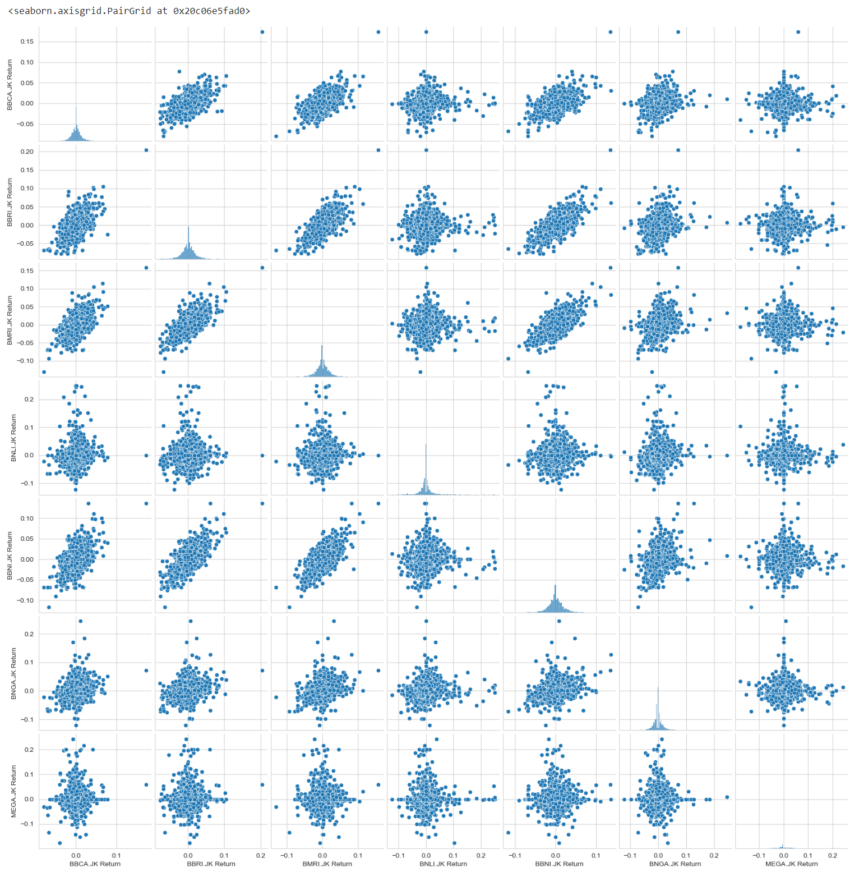
2. Create a Pairplot to identify the relationships
What is the correlation between each pair of bank stocks, and how strong are these relationships?
To identify the relationship, .pairplot( ) function is used to identify correlations, trends, and distribution patterns of each bank stocks
Findings
From the Pairplot visualization, it can be seen that BBCA has a linear positive correlation with BBRI, BMRI, and BBNI. So, if we compare it with MEGA it is more spread out.
Feni Ismiati | ismiatifeni6@gmail.com | 6282210023177

Slide 24
Visualization
Feni Ismiati | ismiatifeni6@gmail.com | 6282210023177

Slide 25
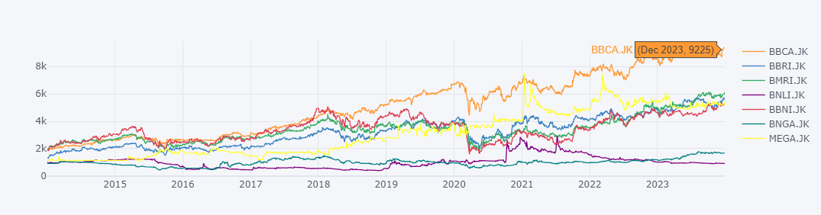
Use Pyplot to create trendline of Close prices over time
How is the Close price trendline using Pyplot?
Using .iplot( ) from Pyplot to create detailed and interactive exploration of Close price for each of bank stocks. You can also point your cursor to see the detailed of Close price for the bank stocks you want to see.
Findings
If we look at the Pyplot chart above, it can be seen that most of the bank stocks tend to increase from 2013 to 2023. But, in the in 2020 around February - March most of the each bank stocks have experience decreased.
Feni Ismiati | ismiatifeni6@gmail.com | 6282210023177

Slide 26
Summary
The range of maximum Close price from each of bank stock from 31 December 2013 to 31 December 2023 is 1,790 - 9,400. Meanwhile the minimum is 382 - 1,865
Most of the minimum and maximum returns of all the bank stocks are occurred in 2020
The highest return came from MEGA (0.094997%), but MEGA (0.027163) also has the highest of standard deviation value which it can be said that MEGA is the most volatile or riskiest
Based standard deviation, the lowest value of standard deviation is coming from BBCA (0.014471) which can be said that BBCA is the most stable, with the average of return is 0.073608%
To see the strength of correlation between each pair of bank stocks, we can see that BBCA shows a strong positive correlation with BBRI (0.97), MEGA (0.94), and BMRI (0.83) indicating that their prices tend to move together. But, Pairplot analysis reveals that the correlation with MEGA is less linear and more scattered compared to the more consistent linear relationships with BBRI, BMRI, and BBNI. This suggests that BBCA stock price movements are more predictably linked with BBRI, BMRI, and BBNI than with MEGA
Feni Ismiati | ismiatifeni6@gmail.com | 6282210023177

Slide 27
Thank You!
Feni Ismiati | ismiatifeni6@gmail.com | 6282210023177

